Slide 1
Designing and Developing Games
Session 01

Slide 2
Outline Material
Task Approach
Key Components
Game Structure
Design Process
Team Roles
Design Documents
Anatomy of Game Designer

Slide 3
Task Approach
Some people think game design as an art, a process of imagination that draws on mysterious wellspring of creativity.
Other people think game design as mathematically or technology oriented. Aesthetics are a minor consideration
Game design is not purely an art. A game includes both artistic and functional elements. The correct approach to game design is by an approach by player-centric.

Slide 4
Task Approach – Misconception in Game Design
Misconception 1: I am my own typical player
Misconception 2: The player is my opponent

Slide 5
Task Approach – Integrating for Entertainment
A game must present an imaginative, coherent experience, so the designer must have a vision
A game must sell well, so the designer must consider the audience’s preferences
A game with license must pay back the license’s cost, so the designer must understand what the fans love about the brand and create a game that resonates with them and meet their expectations
A game must offer an intelligence challenge and a smooth, seamless experience, so the designer must understand the technology
A game must be attractive, so the designer must think about its aesthetic style

Slide 6
Key Components of Game Design
Core Mechanics
Gameplay
User Interface
Player

Slide 7
Structure of Video Game
Gameplay mode
This combination of related items-the available gameplay and its supporting user interface at a given point in a game-collectively described as gameplay mode.

Slide 8
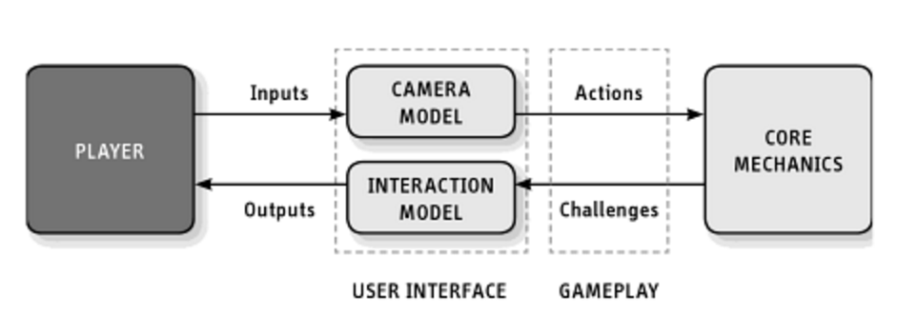
Key Components of Game Design

Slide 9
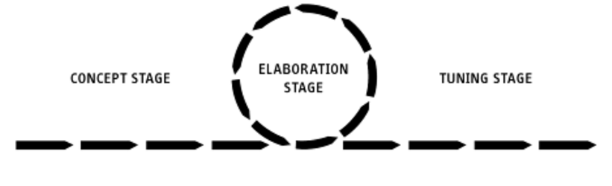
Design Process

Slide 10
Game Design Team Roles
Lead Designer
General Game Designer
Mechanics Designer
Level Designer/World Builder
UI Designer
Writer
Art Director
Audio Director
Lead Programmer
Producer or Project Manager

Slide 11
Game Design Document: Why do we need it?
Design documents are a record of decision made
Design documents turn generality into particulars
Design documents communicate your intentions to the rest of the team and let them plan their task
Design documents are sometimes the basis of contractual obligations
Funding agencies want design document as evidence that you know what you’re doing

Slide 12
Design Documents: Types of Game Design Document
High Concept Document
Game Treatment Document
Character Design Document
World Design Document
User Interface Design Document
Flowboard
Story and Level Progression Document
On-screen Text and Audio Dialog Script
The Game Script

Slide 13
Anatomy of Game Design
Imagination
Technical Awareness
Analytical Competence
Mathematical Competence
Aesthetic Competence
General Knowledge and the Ability to Research
Writing Skills
Drawing Skills
Ability to Synthesize

